Slide 1

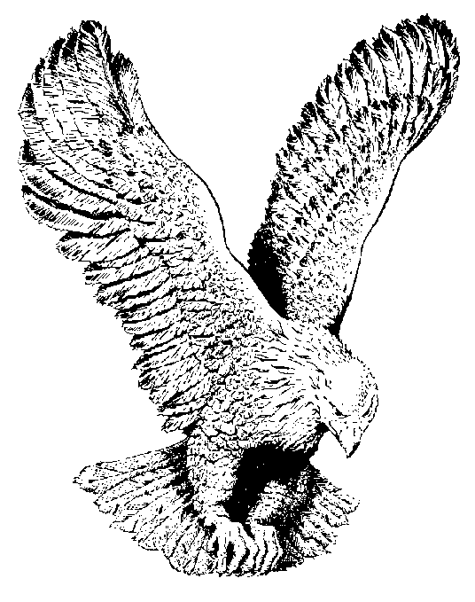
676 SOMETHING A-BURNING
There is something a-burning in my soul
There is something a-burning in my soul
When I sing, when I pray, and all the live
long day
There is something a-burning in my soul.

Slide 2
Peter had something burning in his soul
Peter had something burning in his soul
When he preached that great day
Three thousand sinners prayed
Peter had something burning in his soul.

Slide 3
Don’t you want something burning in your soul
Don’t you want something burning in your soul
Cry aloud to the Lord
Believe His precious Word
Then you’ll have something burning in
your soul.

